Slide 1
The A B C’s of Graphing (Tips to follow)
This presentation is devoted entirely to
Giving you all the necessary hints, tips, rules to follow, and some smart advice, to allow you to look at a given function
and have a decent chance to draw a (maybe rough, but conceptually correct) graph of the function.
The first step is
On a separate sheet of paper draw a cartesian coordinates system of axes, thus

Slide 2
Don’t label units yet, (you don’t know what you’ll need), but label the axes
Set the sheet aside for use later. (your sheet)

Slide 3
Compute the equations (if any) of all asymptotes. This means:
1. Compute the limits
(These will give you the horizontal asymptotes
if either of the two limits is finite, equation
, draw them on your sheet.
2. Find those points near the domain of
where the function may not be defined (in general this is NOT easy, we will learn a helpful tool in the next lecture, Newton’s method.)
Compute

Slide 4
(These will give you the vertical asymptotes if either limit is . Draw them on your sheet.
3. If is a rational function
( and are polynomials)
and the degree of the top is one more than the degree of the bottom, then divide by
to get
where are constants and is a poly-nomial of degree less than . Dividing both sides by we get

Slide 5
whence
This, by definition, says that the straight line with equation is a slant asymptote of .
Draw them in your sheet.
Your sheet now has all asymptotes, horizontal, vertical and slant.
Next set up the usual table with all critical points and relevant intervals and signs, including the two limits at .

Slide 6
You now have all the information needed for a fairly accurate sketch (on your sheet !) of the graph of .
Remarks. A. If what you have on your sheet and in the table will not allow you to draw a decent curve
YOU MADE A MISTAKE !
B. Be smart: if the function is either
even (i.e. ) or
odd (i.e. )
you need only graph it for .

Slide 7
C. If the function is periodic with period
(i.e. is the smallest positive number such
that ) you only
need to graph over the interval ,
because it repeats itself !
We are done with hints, tips, rules to follow, and some smart advice, now we work, on the board, a couple of examples. The equations are:
and

Slide 8
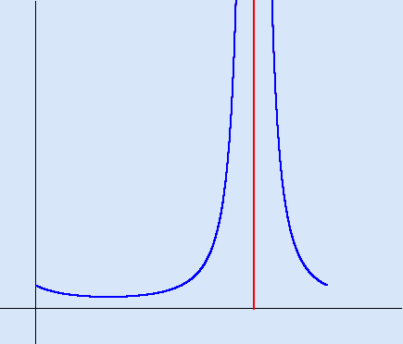
Here is the graph of

